Slide 1

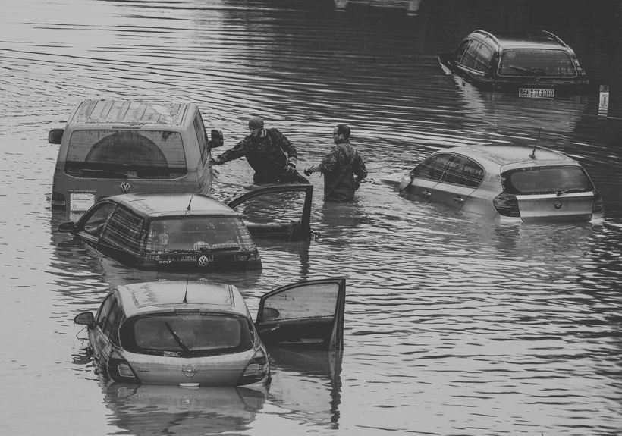
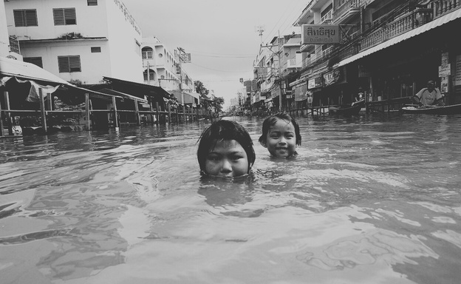
Flood Risk Modelling
using
flood hazard & vulnerability factors
Modelling of the MMR Region in Maharashtra, India
Presented by
Brahad - 2021112004
Manasa - 2022101131

Slide 2
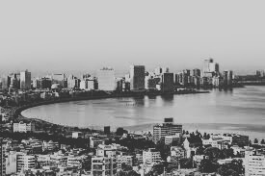
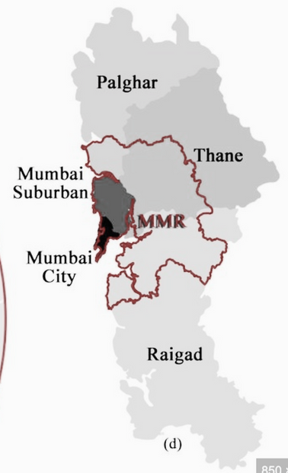
Choosing our
Region of Interest
MMR Region of Maharashtra
Why?
High Population Density and Urbanization: rapid urbanization has led to significant land use changes, reducing natural drainage areas and increasing impermeable surfaces
Monsoon Season Intensity: receives heavy rainfall during the monsoon season, often leading to waterlogging
Climate Change Impact: 2017 floods (heaviest rains in a decade) attributed to global warming
Economic Importance: Mumbai is a major economic center

Slide 3
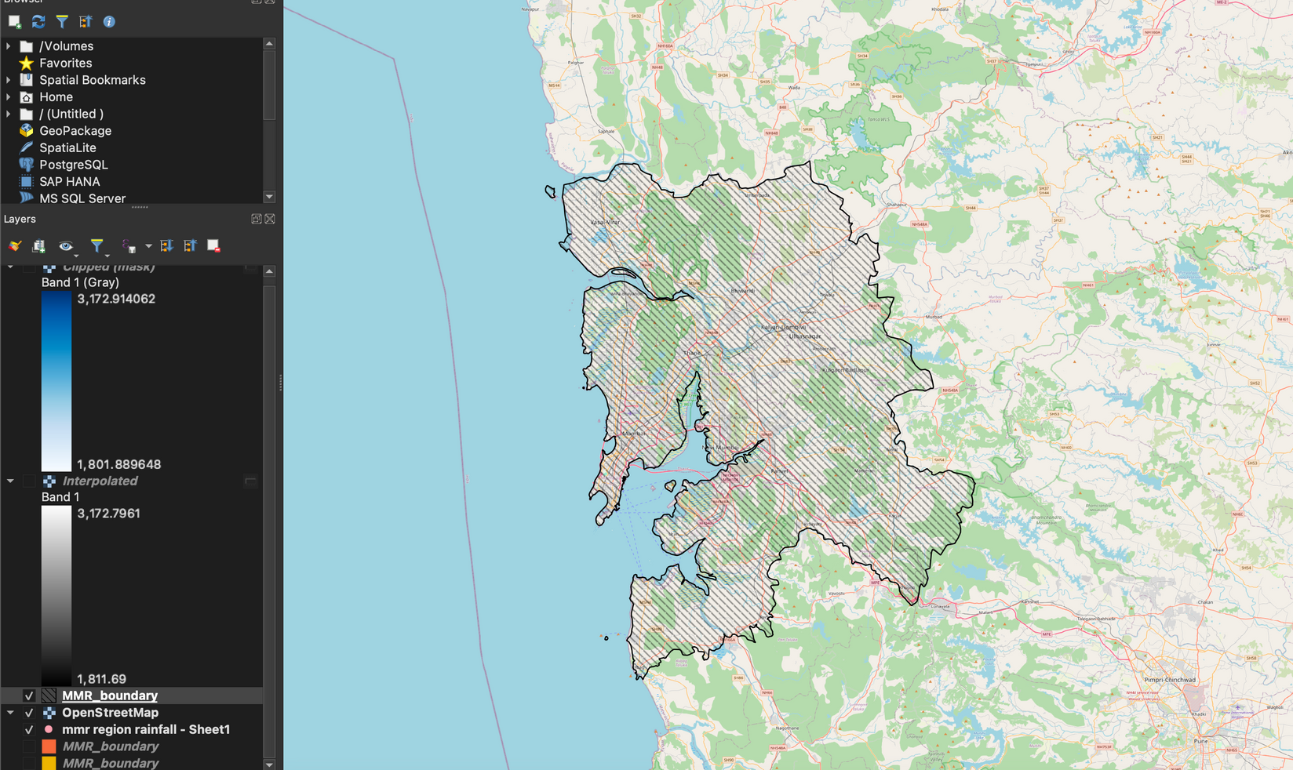
Shapefiles containing the region of interest

Slide 4
Quantifying
Factors Analyzed & Assessed
Flood Risk
Rainfall
Elevation
Slope
Distance from Rivers
Drainage Density
Topological Wetness Index (TWI)
Land Use Land Cover (LULC)
Socio-Economic Factors

Slide 5
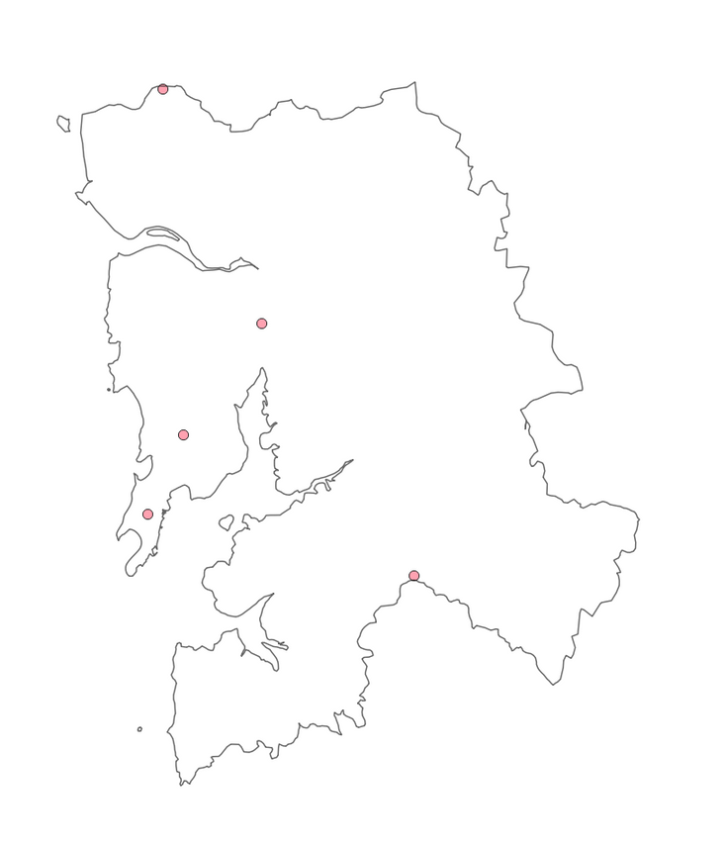
Rainfall in the MMR
Modelling the
Rainfall Map
The Rainfall map was modelled on QGIS using the Spatial Interpolation (IDW) Technique
Data was collected from the CHRS Data Portal for the 5 districts in the MMR: Raigad (Partial), Palghar (Partial), Thane, Mumbai Suburban, and Mumbai City
Datapoints were added onto the shapefile on QGIS as a Delimited Text Layer

Slide 6
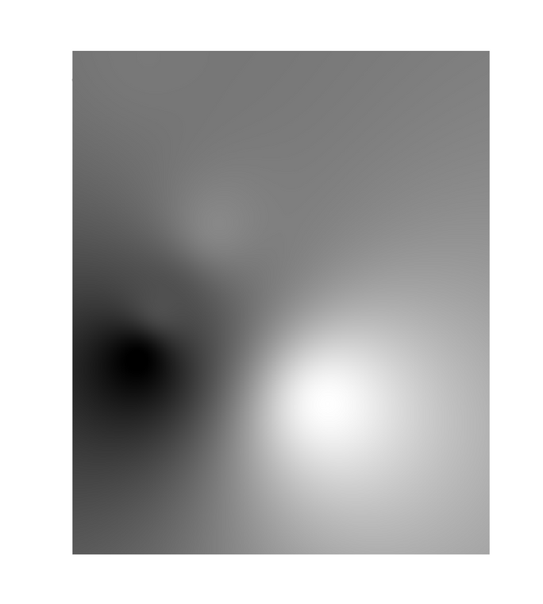
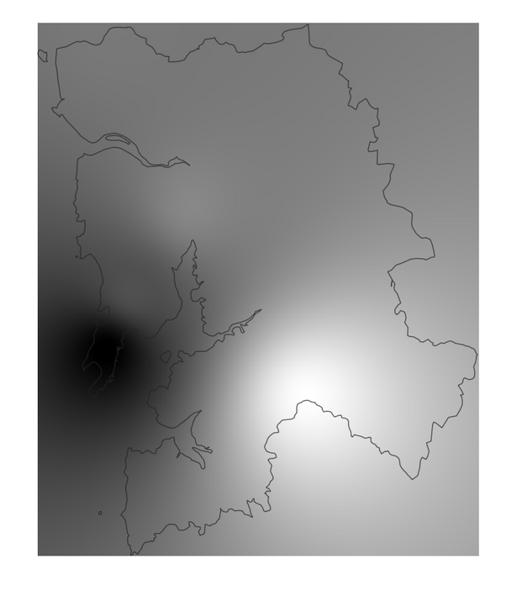
Rainfall in the MMR
Modelling the
Rainfall Map
The Rainfall map was modelled on QGIS using the Spatial Interpolation (IDW) Technique
Now, from the Interpolation Toolbox, I chose IDW Interpolation to add a Vector Layer for the interpolated data.
Pixel size of 0.001
Distance coefficient P of 2.0

Slide 7
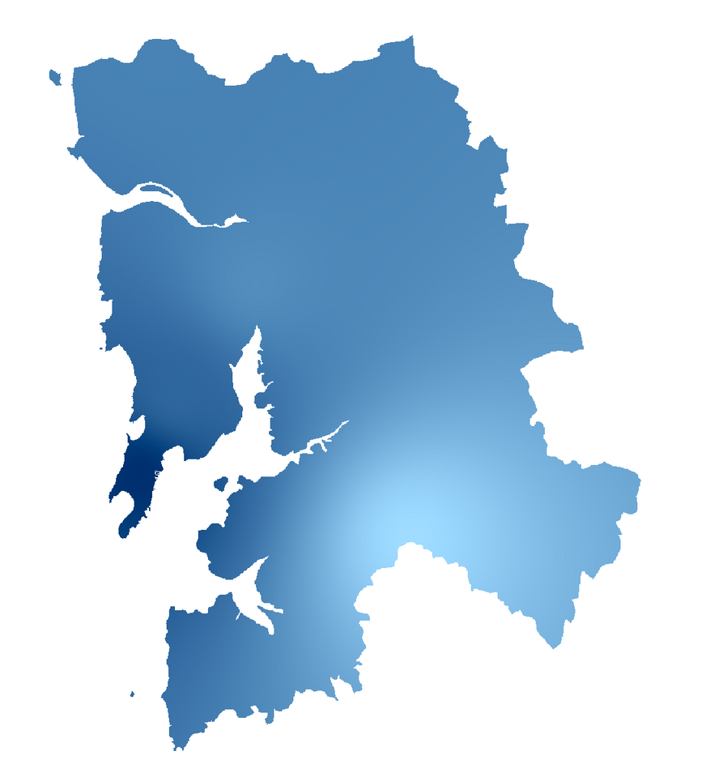
Rainfall in the MMR
Modelling the
Rainfall Map
The Rainfall map was modelled on QGIS using the Spatial Interpolation (IDW) Technique
To extract only the shapefile, I went to the Raster Tool and chose Extraction > Clip Raster by Mask Layer. This resulted in a crisp extraction of the interpolation. Then I modelled the intensity on a blue scale.
Mumbai City

Slide 8
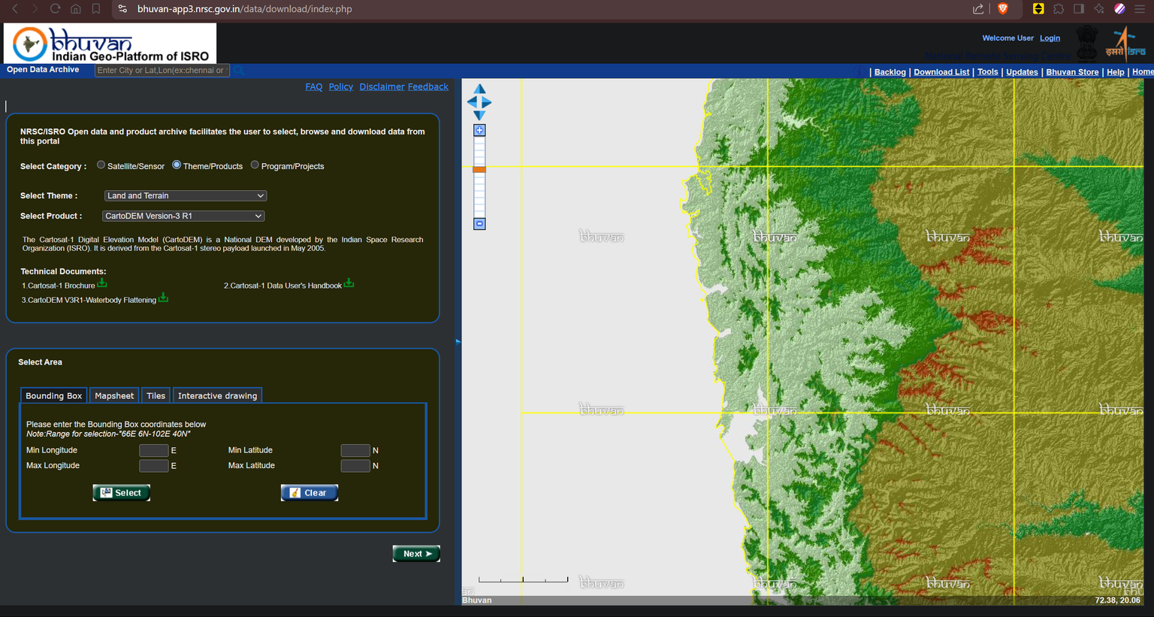
Elevation
Most straightforward of all, we imported DEM data from the Bhuvan portal.
From CartoDEM3 we take 4 tiles which are required to cover our ROI and then merge them in QGIS to get one raster layer.

Slide 9
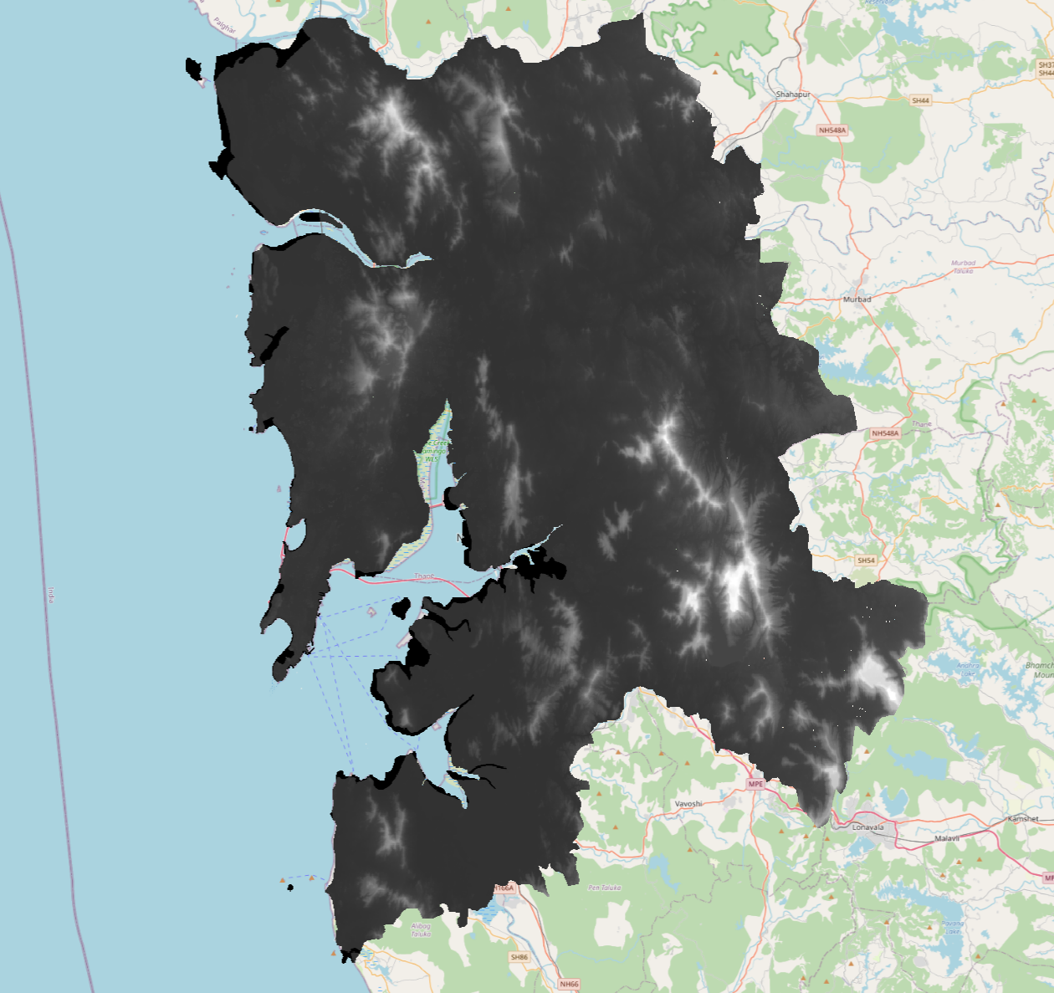
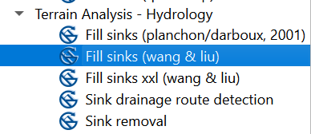
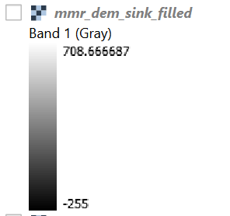
Elevation
We then fill the sinks in it using Fill sinks (wang & liu).
This gets rid of sudden changes in the DEM data which would have resulted in absurd slopes and would have thus hindered further analysis.

Slide 10
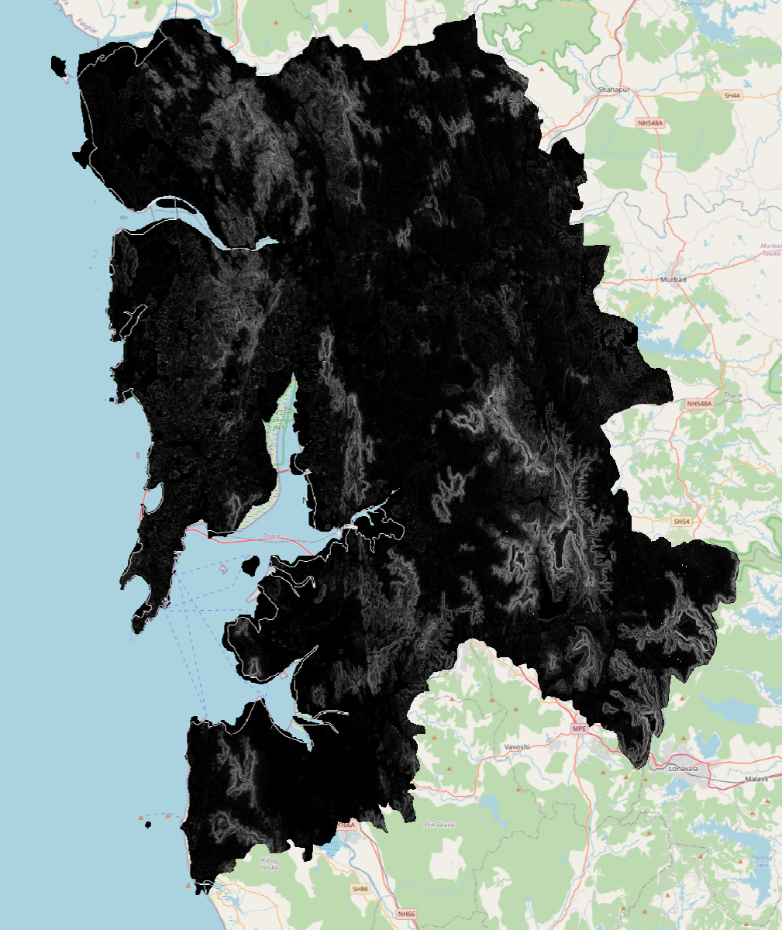
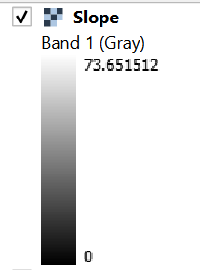
Slope
From the sink-filled DEM we get the slope map using the Slope tool in the Raster terrain analysis toolbox.
The z-factor is a conversion factor that adjusts the units of measure for the vertical (or elevation) units when they are different from the horizontal coordinate (x,y) units of the input surface. It is the number of ground x,y units in one surface z-unit. If the vertical units are not corrected to the horizontal units, the results of surface tools will not be correct.
Given that the latitude of Mumbai is about 19 degrees, we choose our Z-factor to be 0.00000956.
Source: https://pro.arcgis.com/en/pro-app/latest/tool-reference/spatial-analyst/applying-a-z-factor.htm

Slide 11
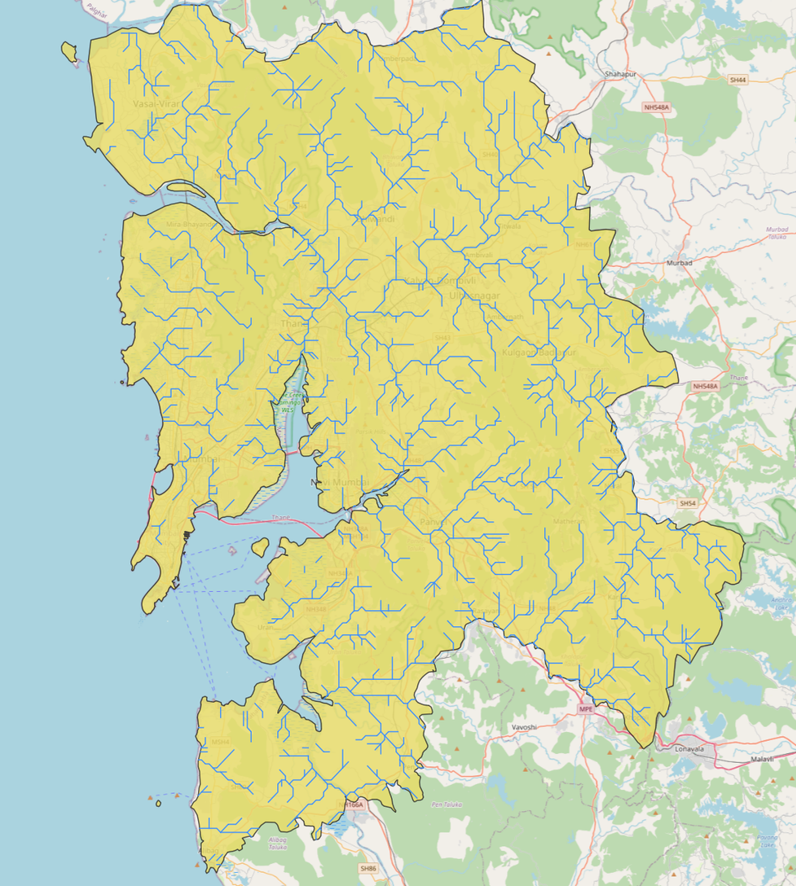
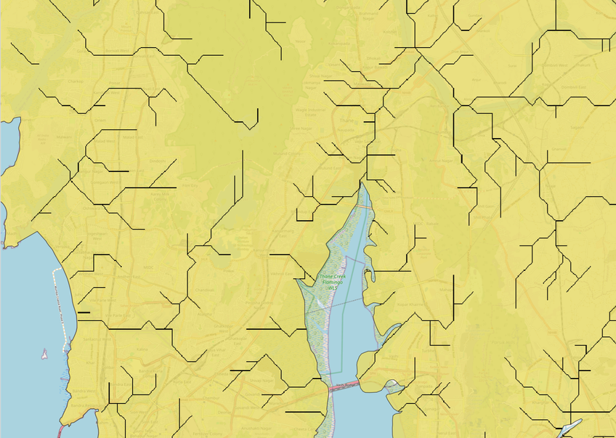
Rivers and Streams
Rivers and streams are an important factor in flood risk assessment, because in a flood event these streams overflow and affect their banks.
i.e., a region closer to a stream is at a greater flood risk

Slide 12
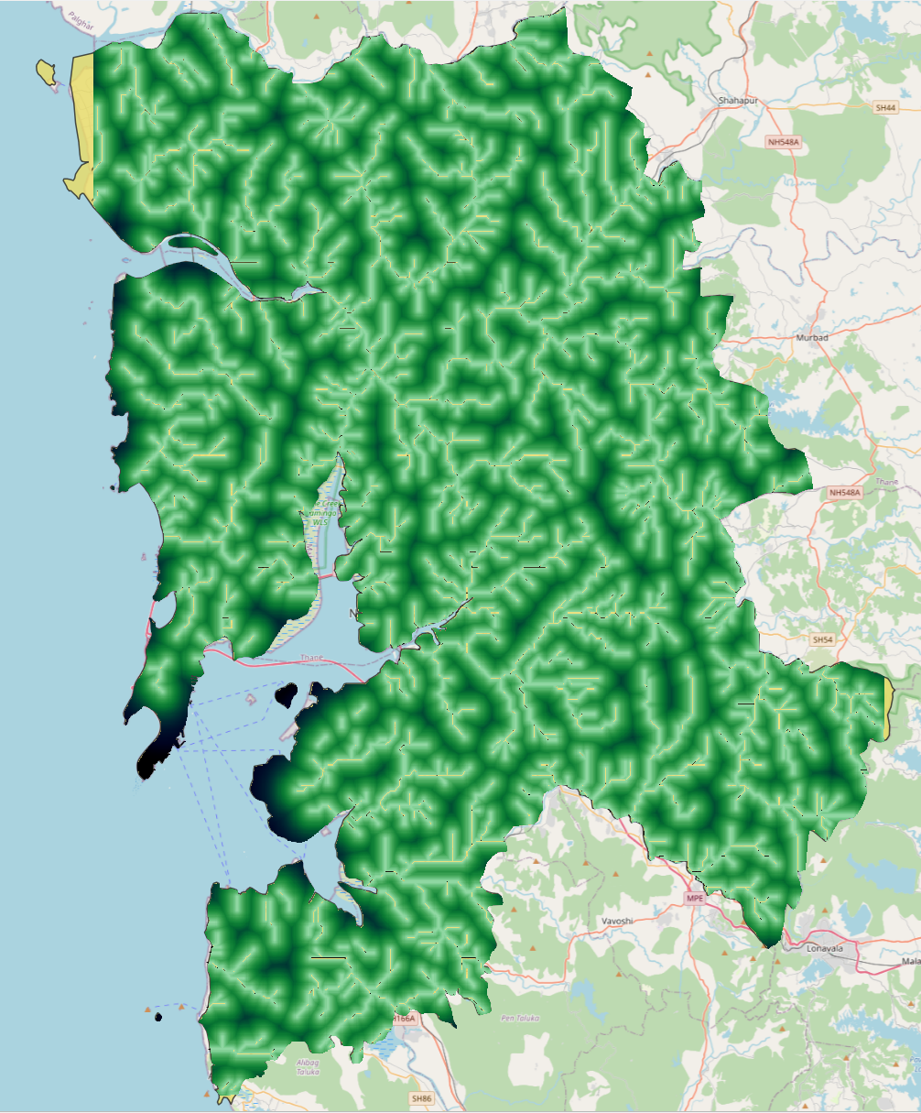
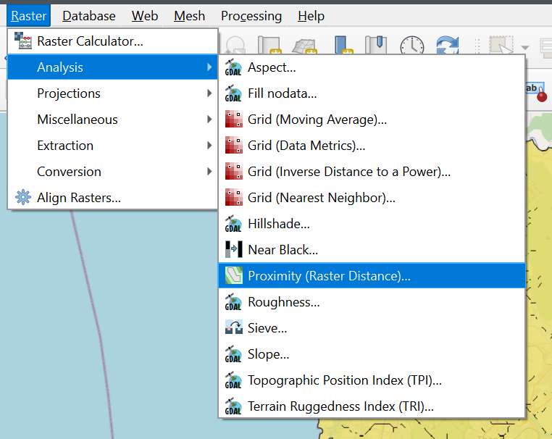
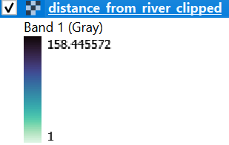
Distance from Rivers

Slide 13
Drainage Density
Now from the Interpolation toolbox we use the Line density tool to create a Raster layer for drainage density.
Search Radius: Defines the distance (in map units) around each cell where QGIS will search for line features to include in the density calculation.
Pixel Size: The resolution of the output raster layer. Smaller pixel sizes give higher resolution but can increase processing time and file size.
distance in degrees ≈ (distance in meters / 111,320) / cos(19°)
Approximate Values for 19° Latitude
Search Radius: ~0.0047–0.0094 degrees
Pixel Size: ~0.00009–0.00028 degrees

Slide 14
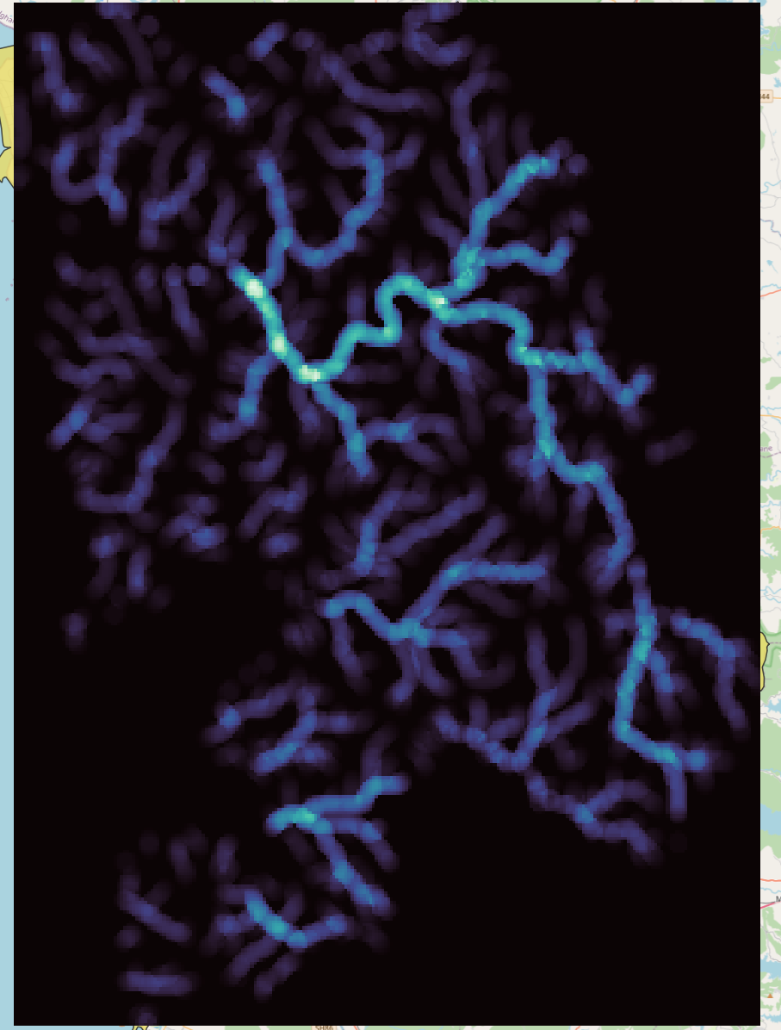
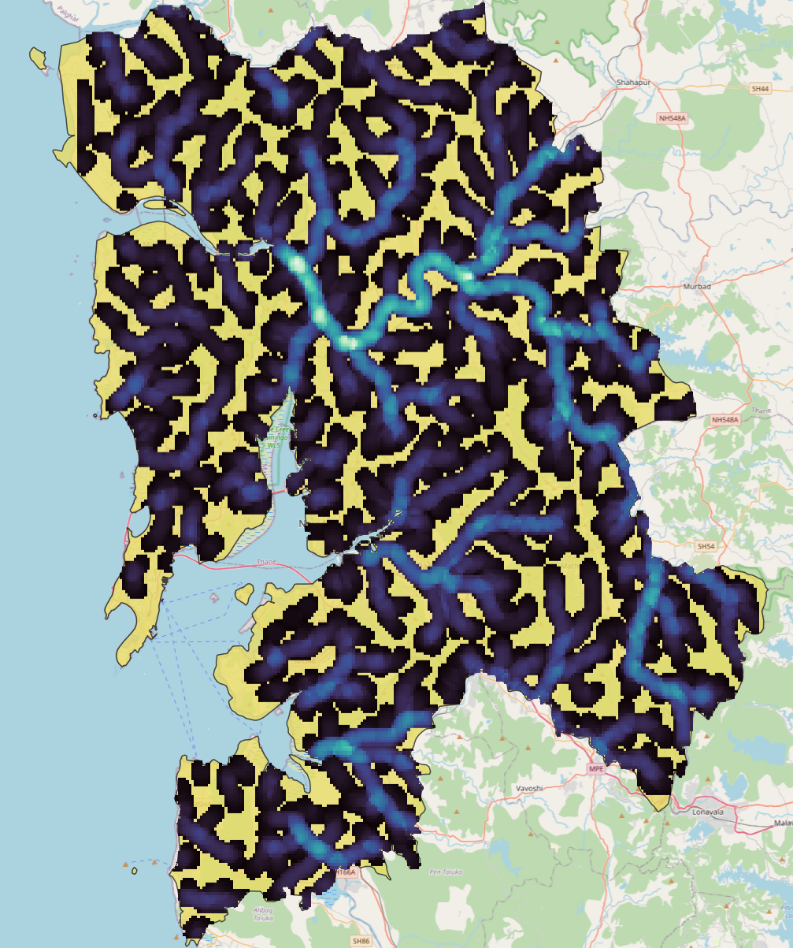
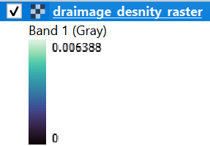
For Search radius 1000m = 0.0094 and Pixel size of 300m = 0.0028 degrees

Slide 15
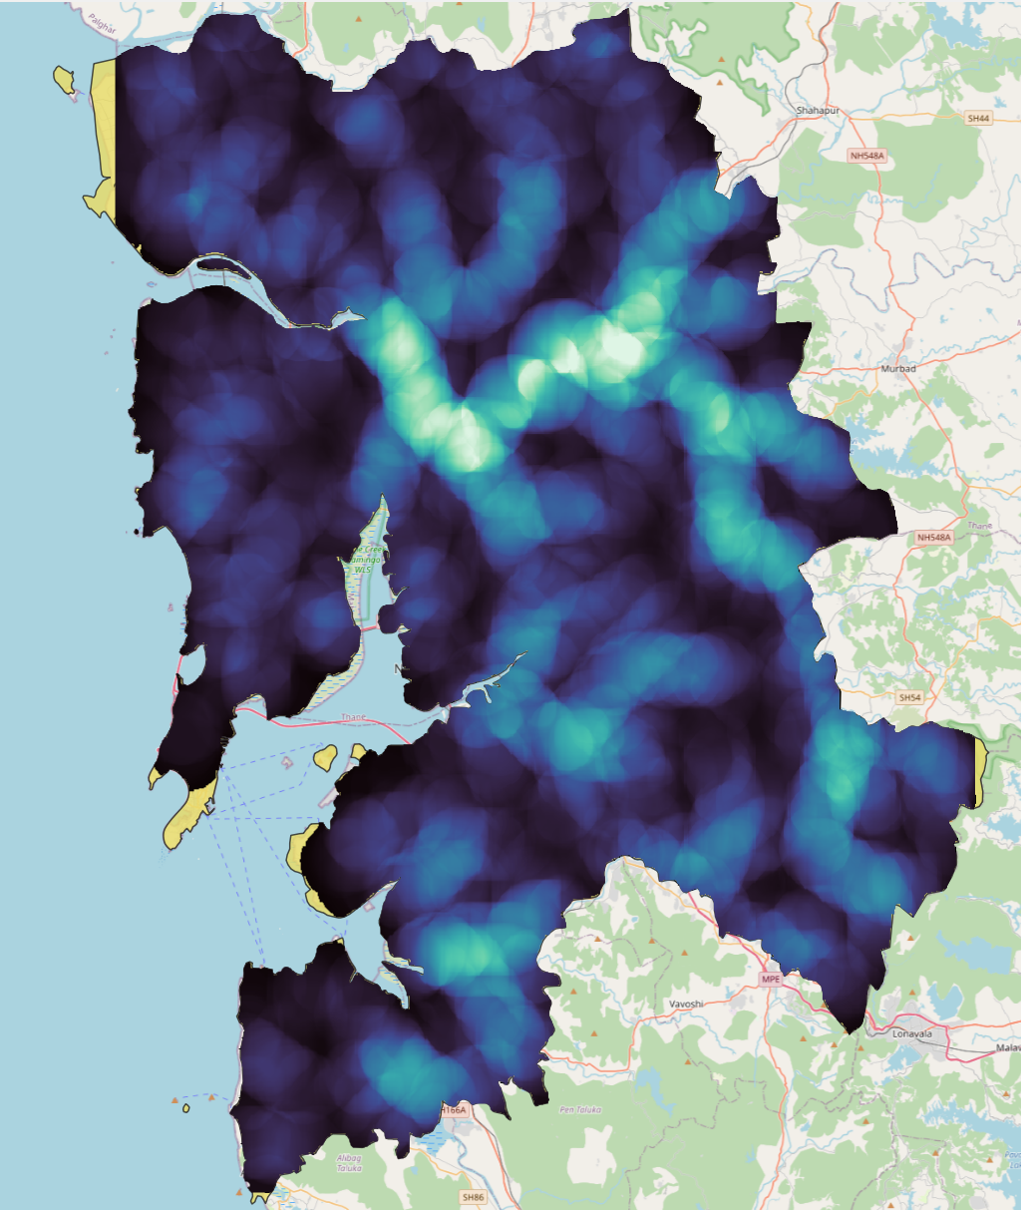
Drainage Density
So here we see that there are many no-data values, which is bad because these areas will then have misleading calculations. Therefore we need to increase the search radius. We triple the radius to 3000m.
For Search radius 3000m = 0.0282 and Pixel size of 100m = 0.0009 degrees we have the following:
distance in degrees ≈ (distance in meters / 111,320) / cos(19°)

Slide 16
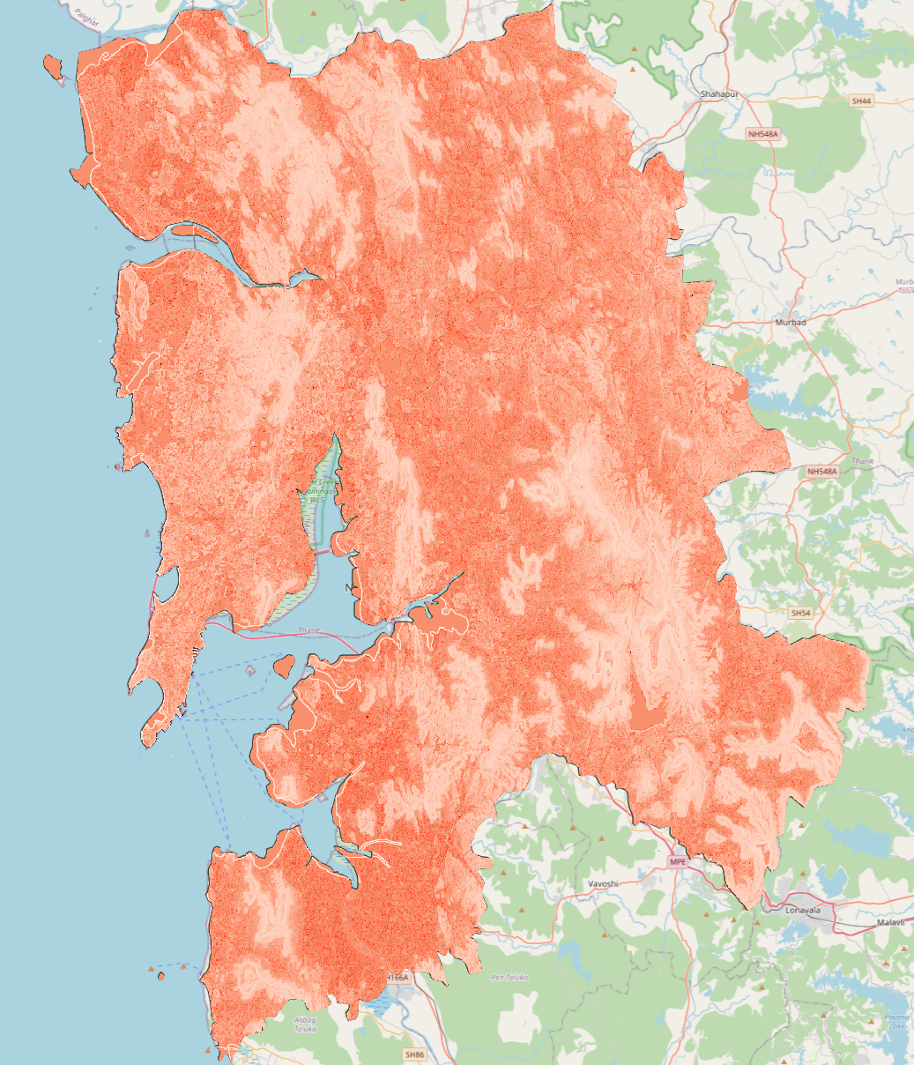
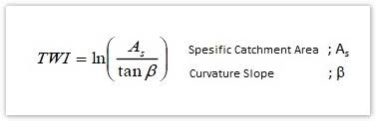
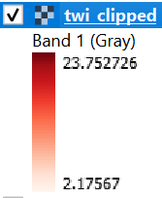
Topological Wetness Index (TWI)
The topographic wetness index (TWI), which combines local upslope contributing area and slope, is commonly used to quantify topographic control on hydrological processes.

Slide 17
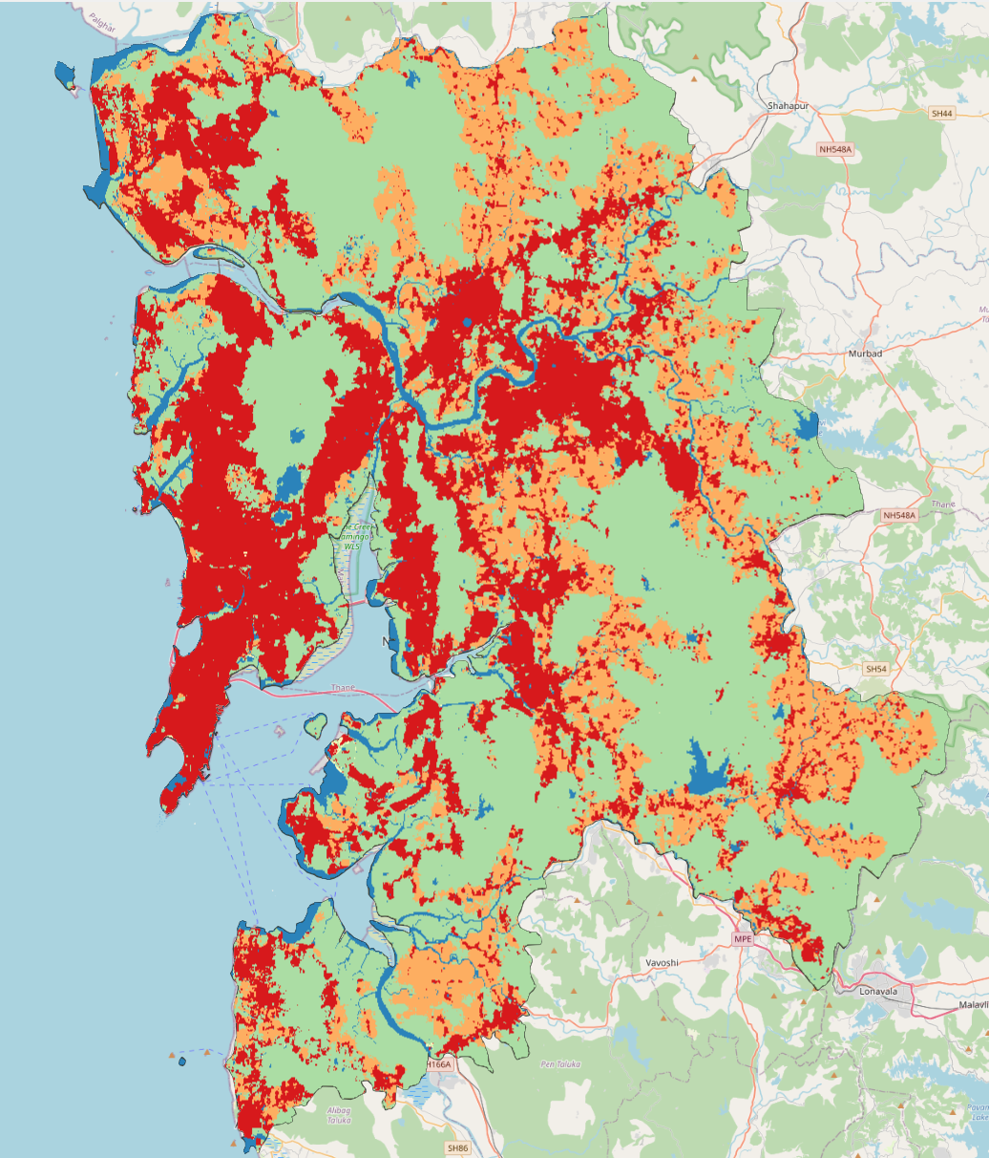
LULC
Land use and land cover (LULC) is important for assessing flood risk because different types of land use impact the rate of infiltration, which can lead to increased runoff and a higher risk of flooding
Water
Trees
Flooded Vegetation
Built area
Crops
Bare ground
Rangeland

Slide 18
Flood Risk Modeling

Slide 19
Weighing factors through literature and AHP
Our final flood risk model works on a weighted average of the 7 layers:
Slope
Elevation
Rainfall
LULC
TWI
Distance from rivers
Drainage density
To decide these weights we did an extensive literature review.
Some did cost/economic damage based analysis to decide on the weights (Waghwala Et al.)
Others create a frequency ratio map (Samantha Et al.)

Slide 20
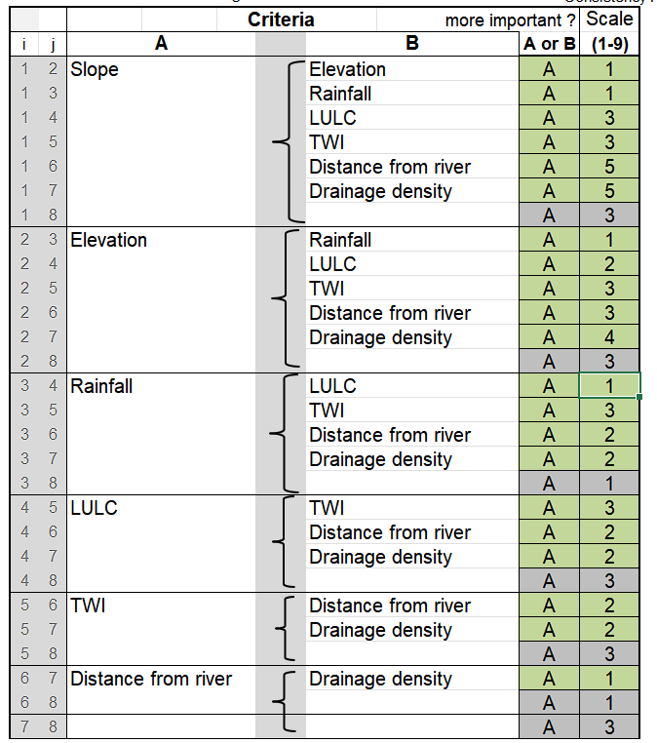
Weighing factors through literature and AHP
Now, based on these we perform an Analytical Hierarchy Process (AHP) (Saaty Et al.)
AHP derives ratio scales from paired comparisons of criteria, and allows for some small inconsistencies in judgments. Inputs can be actual measurements, but also subjective opinions.
Mathematically the method is based on the solution of an Eigenvalue problem. The results of the pair-wise comparisons are arranged in a matrix. The first (dominant) normalized right Eigen vector of the matrix gives the ratio scale (weighting), the Eigenvalue determines the consistency ratio.

Slide 21
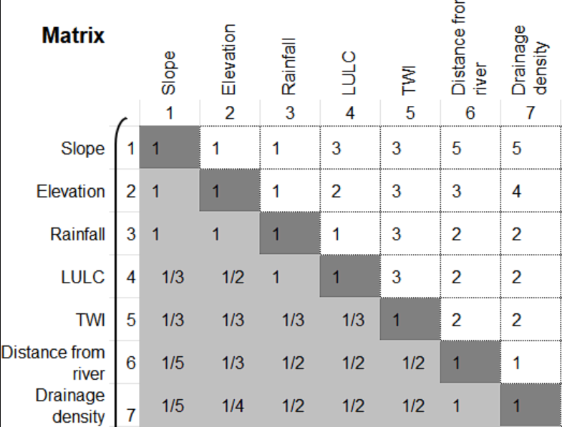
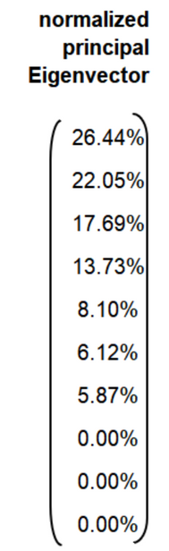
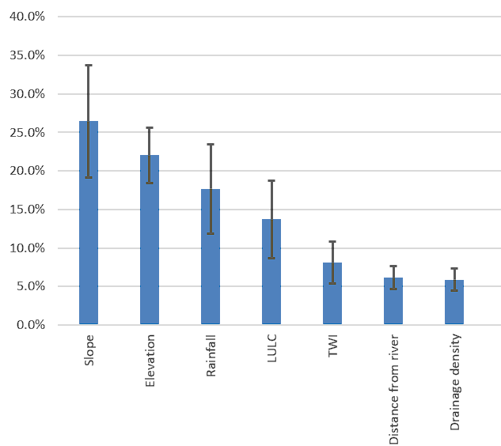
S. no. | Factor | % importance | Normalized weights
1 | Slope | 26.44 | 0.2644
2 | Elevation | 22.05 | 0.2205
3 | Rainfall | 17.69 | 0.1769
4 | LULC | 13.73 | 0.1373
5 | TWI | 8.10 | 0.0810
6 | Distance from river | 6.12 | 0.0612
7 | Drainage density | 5.87 | 0.0587

Slide 22
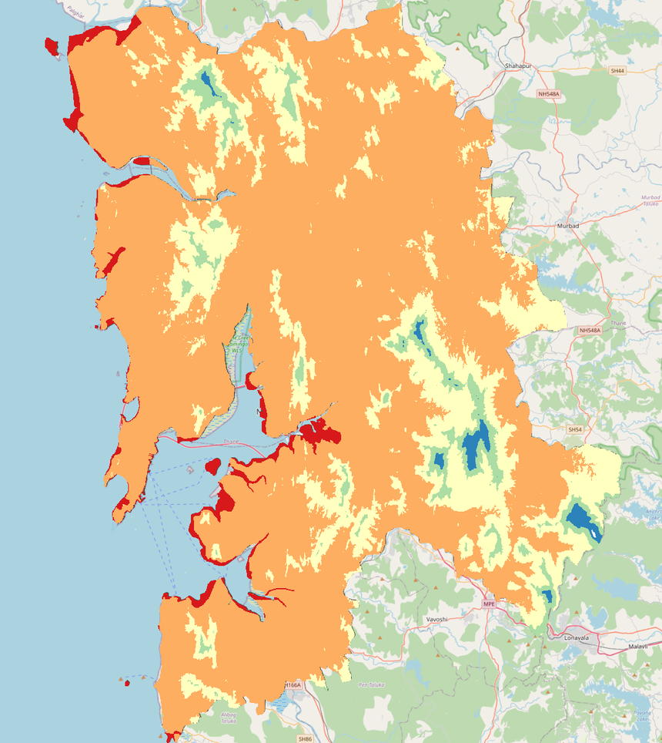
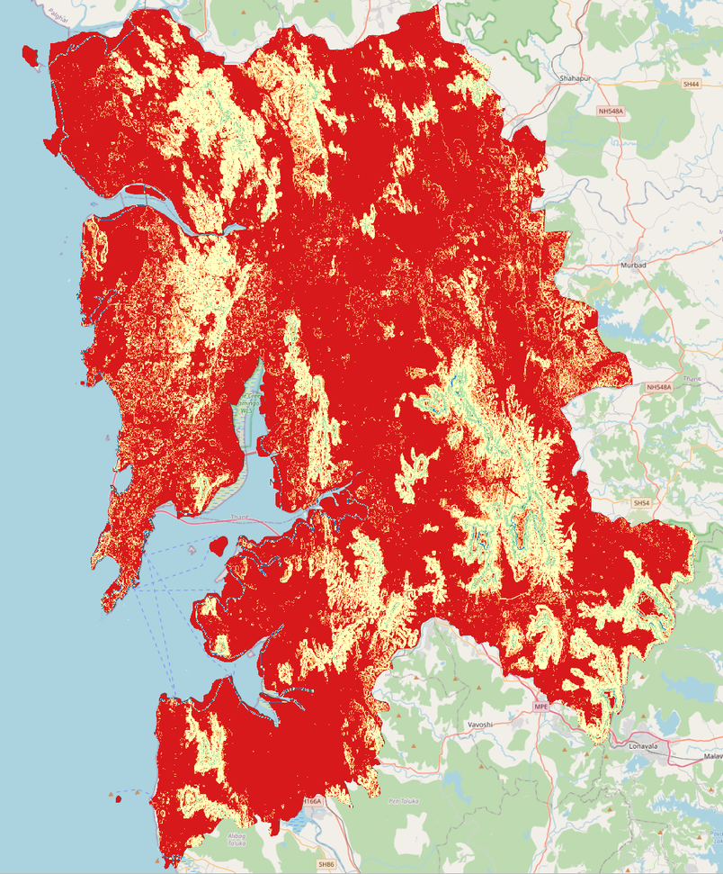
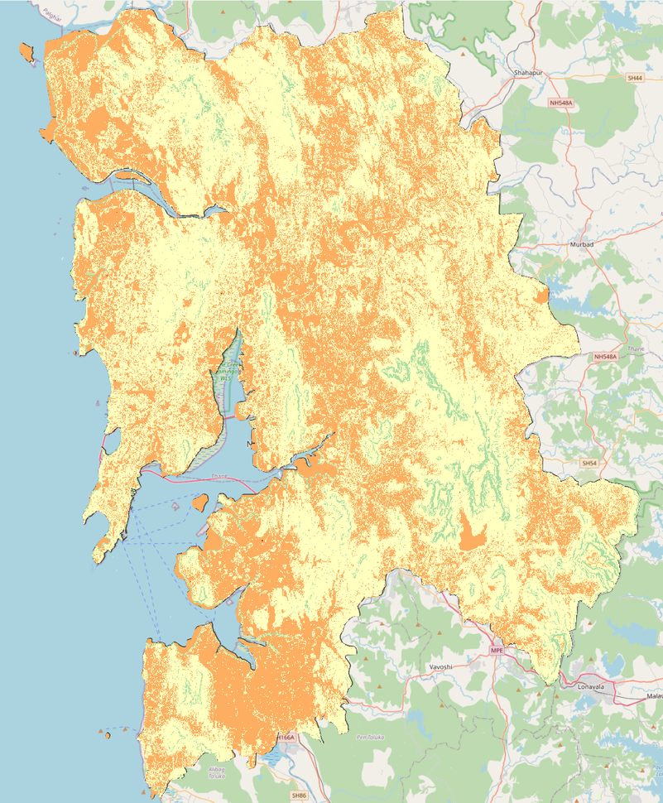
Reclassifying layers in QGIS
Reclassified Elevation
Reclassified Slope
Reclassified TWI

Slide 23
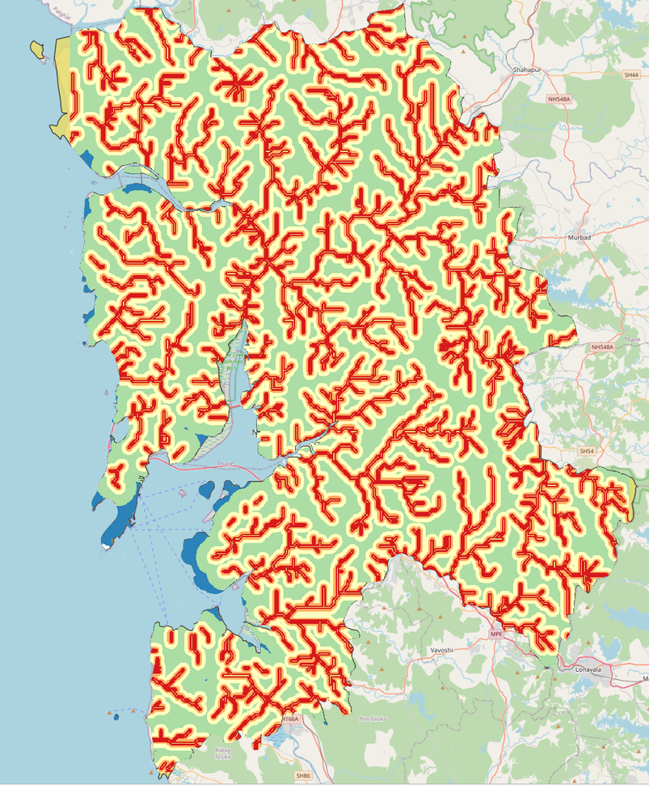
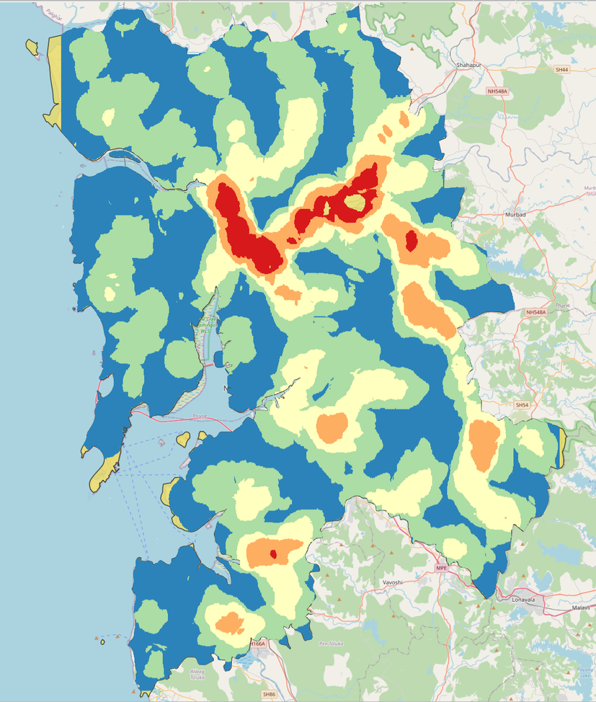

Reclassifying layers in QGIS
Reclassified Dist. from River
Reclassified Drainage Density
Reclassified LULC

Slide 24
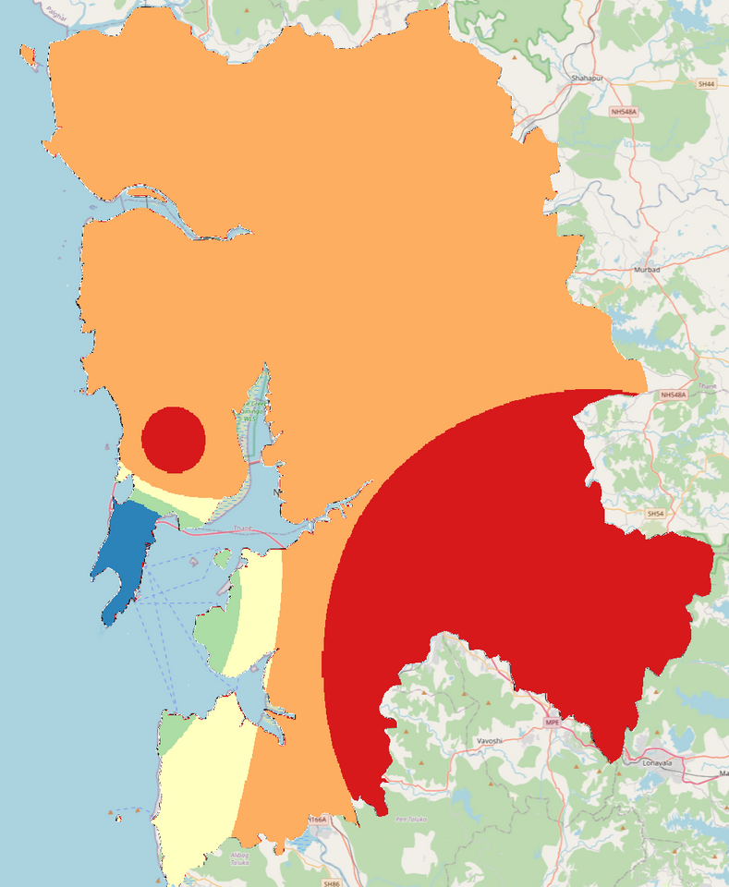
Reclassifying layers in QGIS
Reclassified Rainfall

Slide 25
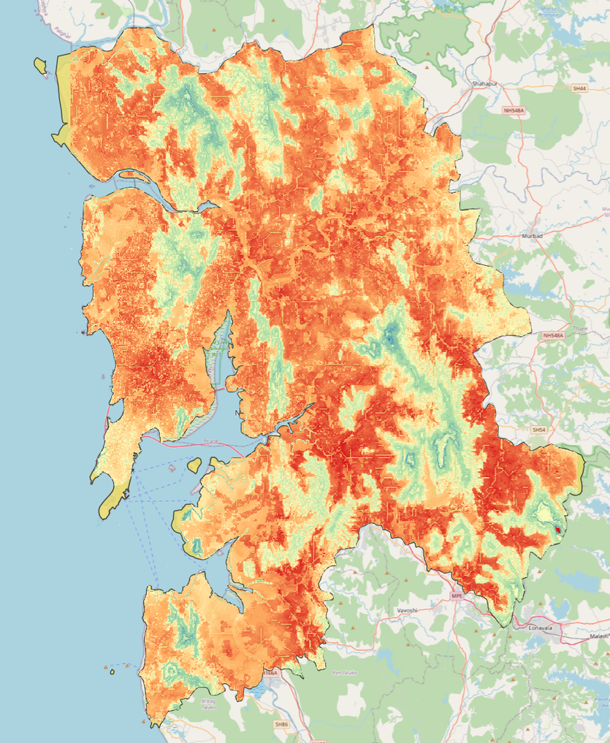
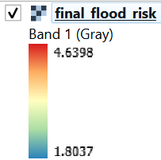
Final Raster Calculation
Finally, weighing all the layers we get the overall flood risk over our ROI.
(0.2644*"slope@1") + (0.2205*"elevation@1") + (0.1769*"rainfall_gaussian_filtered@1") + (0.1373*"lulc@1") + (0.0810*"twi@1") + (0.0612*"dist_riv@1") + (0.0587*"drain_dens@1")
End Result

Slide 26
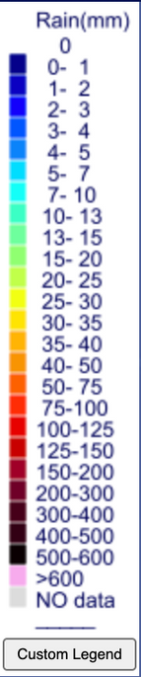
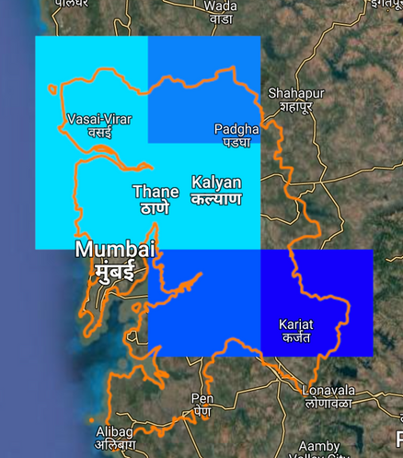
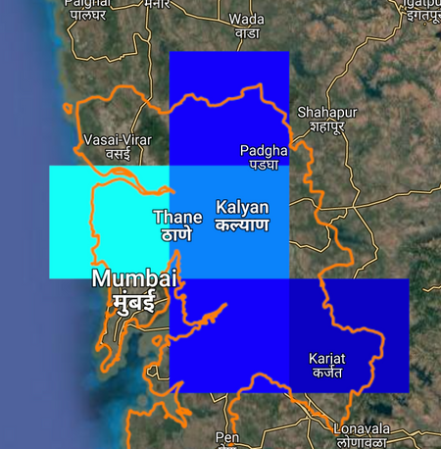
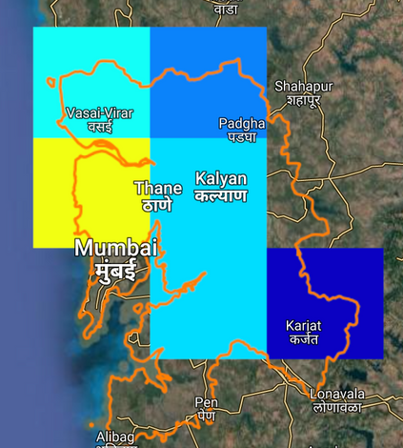
Validating Results
Comparison with
Raw Data
Raw Data from CHRS Data Portal
Mumbai City
Mumbai City received the most rainfall during the 2017 floods in the MMR

Slide 27
Topology/Geography
1 . Mumbai City District
Flood Risk: Highest
Topographical Factors:
Low Elevation and Flat Terrain: Mumbai City is predominantly low-lying which facilitates the accumulation of floodwaters
Coastal Location: directly exposed to the Arabian Sea, making it susceptible to coastal flooding and storm surges
Proximity to Major Water Bodies: increases the risk of riverine and pluvial flooding
Geographical Factors:
Western Ghats Influence: cause orographic rainfall, enhancing precipitation intensity during the monsoon season
Urban Geography: dense urban landscape with high-rise buildings and limited green spaces increases surface runoff
Drainage Infrastructure: often inadequate to handle extreme rainfall events, especially during high tides

Slide 28
Socioeconomic Factors
1 . Mumbai City District
Flood Risk: Highest
Socioeconomic Factors:
High Population Density: one of the highest population densities in the worl which increases flood risk due to pressure on drainage and infrastructure
Economic Impact: Being a financial hub, flooding in Mumbai City leads to significant economic disruptions
Limited Drainage Infrastructure: Older drainage systems struggle with extreme rainfall and tidal influences
Health Risks and Poor Sanitation: mix with waste in densely populated slum areas, increasing disease risks post-flood

Slide 29
Resources and References
Rainfall data: https://www.mahahp.gov.in/DisplayRainfall.aspx?data=Rainfall
Shapefiles: https://github.com/IDFCInstitute/Cities_data/tree/master/Mumbai/Shapefiles/Municipal_Boundary
LULC: https://livingatlas.arcgis.com/landcoverexplorer/
River Network: https://www.hydrosheds.org/products/hydrorivers#downloads
AHP: https://bpmsg.com/ahp/
https://ijahp.org/index.php/IJAHP/article/view/590
Other references:
https://www.cityresource.in/data.html
https://www.sciencedirect.com/science/article/abs/pii/S2212420918314493?via%3Dihub
https://link.springer.com/article/10.1007/s13201-018-0710-1
https://onlinelibrary.wiley.com/doi/10.1155/2021/6128609
https://www.omdena.com/blog/flood-risk-assessment-using-ahp-and-ml-togo

Slide 30
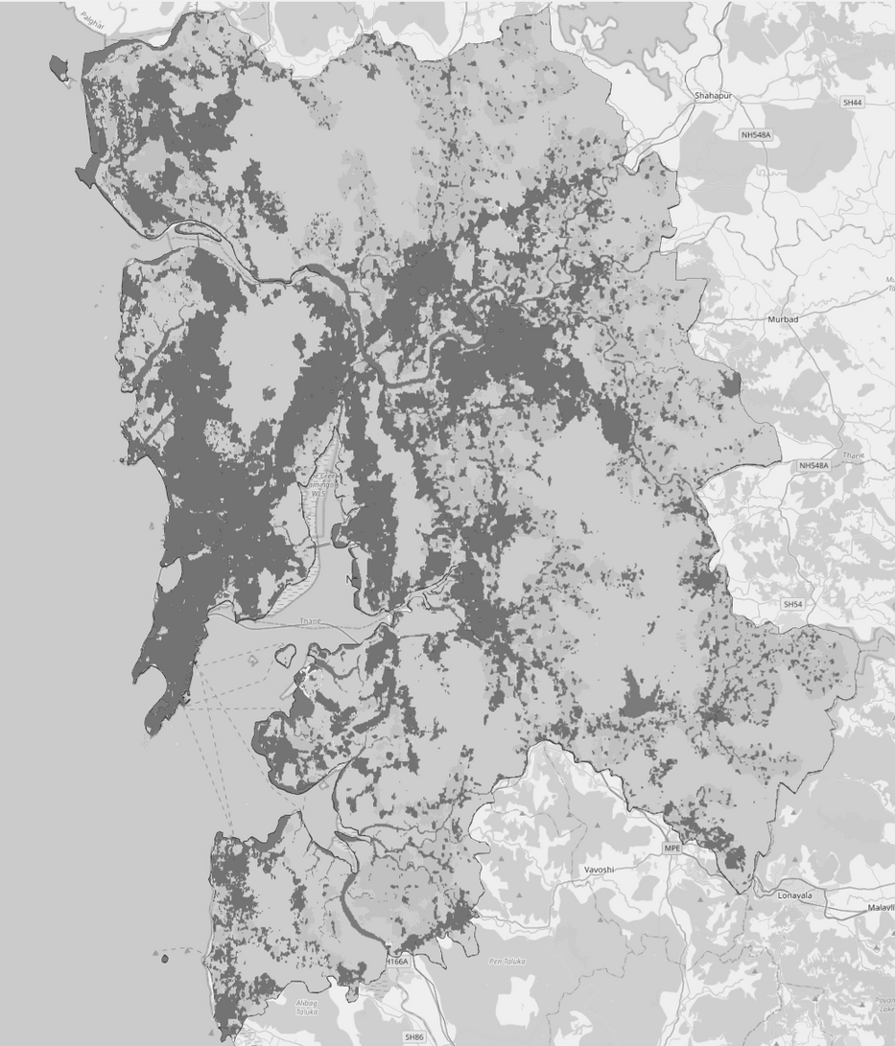
Thank You
For Your Attention

